Slide 1

TOP CAREER CHOICES IN 2021 (CS)
ANDREW JOEL A M
CSE 3RD YEAR

Slide 2
CONTENTs:
Introduction
5 major careers
Why YOU can get that job?
Any last words?

Slide 3
WHY CS is BEST IN 2020+ ?
Digital India revolution. (2015)
Dynamic nature of computer science.
The sector has increased its contribution to India’s GDP from 1.2% in 1998 to 7.7% in 2017. ( == Good money :) )
Increasing demand of skilled software engineers.

Slide 4
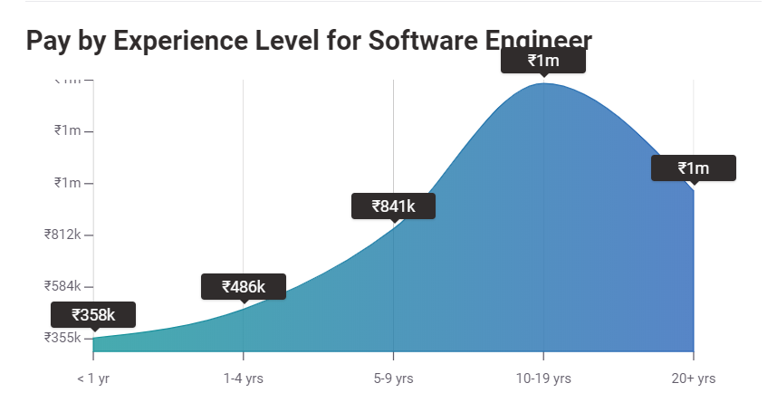
Source: payscale.com

Slide 5
5 MAJOR SOFTWARE CAREERS (India scope)
Web Developer
Back-end Developer
Cyber Security Specialist
Data Scientist
Full-Stack Engineer

Slide 6
WEB DEVEOPER
Requires knowledge in front-end(HTML, CSS, JS) and back-end( Databases, Server-side scripting, etc).
Less saturated field. ( == more work opportunities).
Requires broad scope of knowledge in current web technologies.
Can freelance and/or work in corporates. (Evergreen work field).

Slide 7
Back-end developer
One word: DATA.
Need Database skills (Oracle, MongoDB) and Programming Language skills (Java, C#, .NET, Python).
Can work in various companies (even non-IT companies).
Lucrative (with payoff for skills).

Slide 8
Cyber-security specialist
That one guy in server room who runs the company.
Save the company’s infra and safeguard “DATA” at all costs!
(Reasoning, Aptitude, Networking) > Coding skills.
Work for any institution (Govt. , Pvt. ).
Most needed job in India. (Data security crisis).

Slide 9
Data scientist
“The hottest job in 21st century” – Harvard Business Review(2012).
Why ? Because data is the new “oil”.
Incredible and ludicrous salary packages (I’m serious).
Basics: Python, Math(Statistics, Linear Algebra, Regression), Data Visualization.
AI, ML, DL are pullingo of DS. ;)

Slide 10
FULL STACK Engineer
All-in-all Azhaguraja, Jack-of-all trades, Swiss Army Knife, AB de Villiers of CS, etc.
Full stack = Front-end + Back-end.
Initially hard but later it will be easy.
Know to design UI/UX and develop back-end systems.
Can work for many years in this field.

Slide 11
Why you can get a job easily?
90% of learning is FREE! (YouTube, websites etc.).
Easier to learn when you have strong foundation in CSE / IT.
No need to learn everything!
Almost all conservative jobs will be related to CS from this decade.
Getting into the company > Pursuing higher studies.

Slide 12
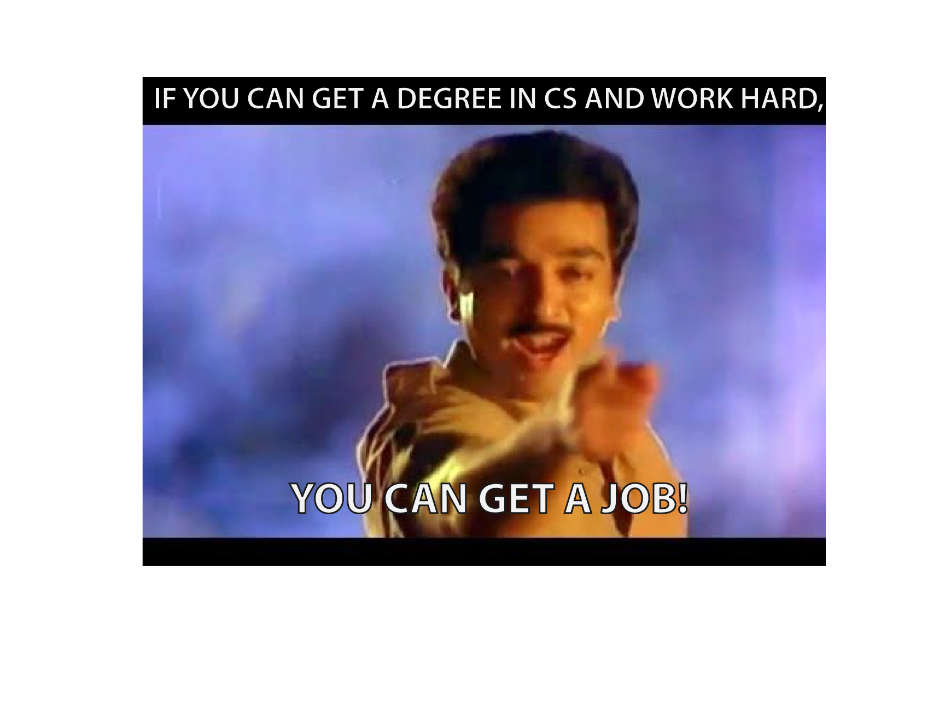

Slide 13
GOOD LUCK AND THANK YOU FOR LISTENING!

